Slide 1
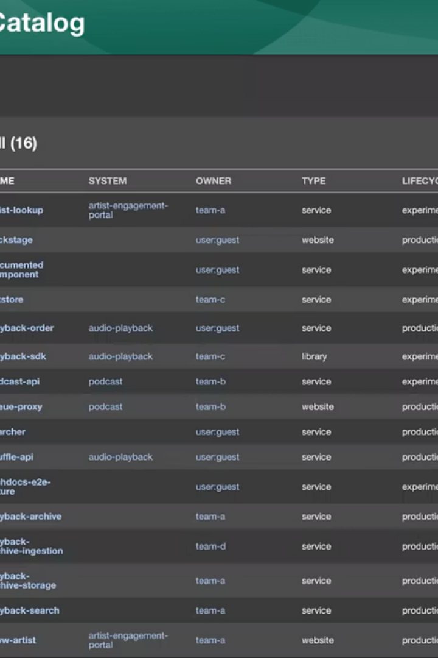
Backstage by Spotify: A Developer Portal Framework
Created by Spotify in 2020, Backstage is an open source framework now donated to the Cloud Native Computing Foundation. It's been adopted by over 2,600 companies worldwide.
Backstage serves as a centralized platform for the entire software development lifecycle, bringing order to complex engineering ecosystems.
TS
by Techlanders Solutions

Slide 2
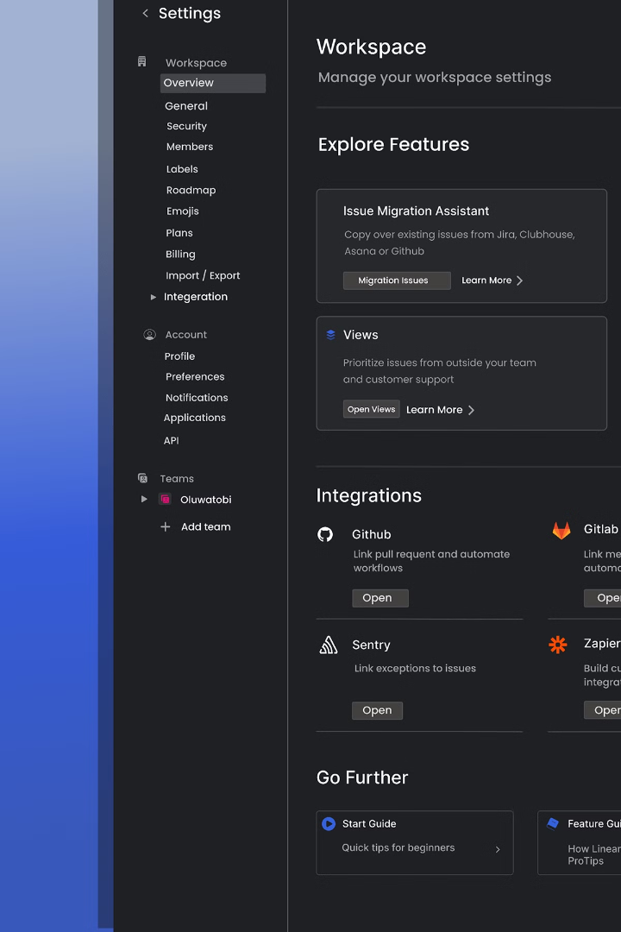
What is Backstage?
Internal Developer Portal
Microservice Management
A central hub for developers to access all tools and resources. Unifies the engineering ecosystem under one roof.
Provides visibility into your microservices landscape. Helps teams maintain and discover services across your organization.
Plugin Architecture
Extensible framework with plugins for different needs. Customizable to fit your organization's specific requirements.

Slide 3





The Problem Backstage Solves
Fragmented Tooling
Multiple disconnected systems across the development lifecycle cause friction.
Ownership Confusion
Unclear who owns which services leads to delayed incident response.
Inconsistent Practices
Different teams follow different approaches to solving similar problems.
Documentation Chaos
Critical information scattered across wikis, docs, and repositories.

Slide 4
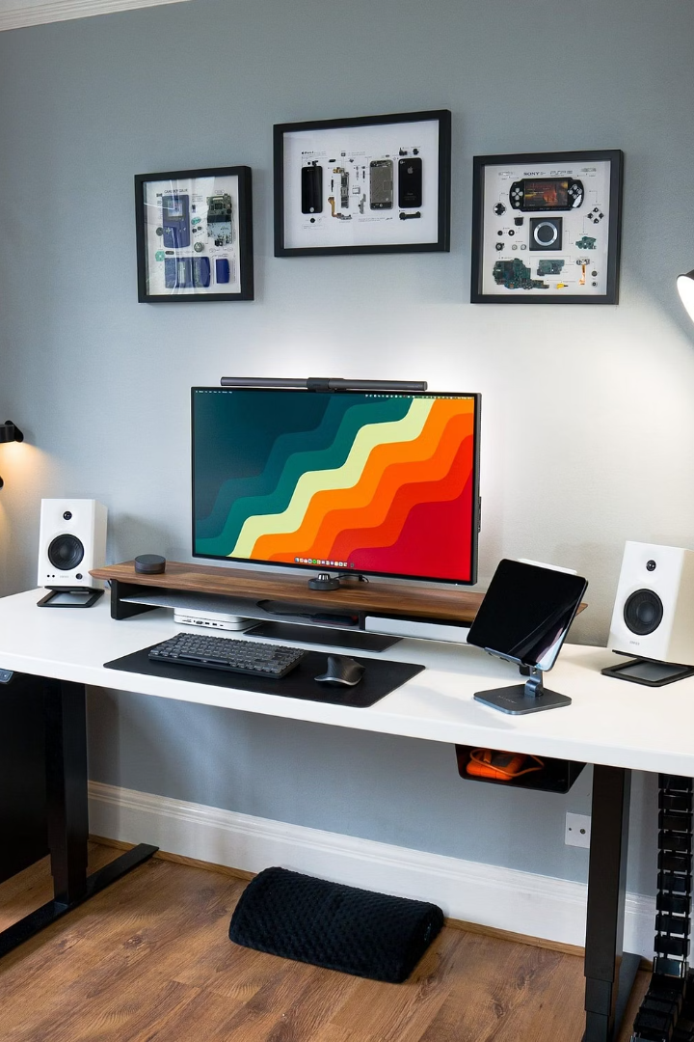




Key Benefits of Backstage
Centralized Visibility
Single place to discover and manage all software components.
Standardized Development
Common patterns and practices across teams reduce cognitive load.
Unified Documentation
Technical documentation lives with code and is easily accessible.
Enhanced Collaboration
Teams can more easily discover and build upon each other's work.

Slide 5






Backstage Architecture Overview
Frontend Experience
Unified interface for all developer needs
Plugin Ecosystem
120+ plugins at Spotify extending functionality
Backend Services
Integration with existing infrastructure
Built on modern web technologies, Backstage provides a flexible framework that can be customized to fit any organization's needs.

Slide 6
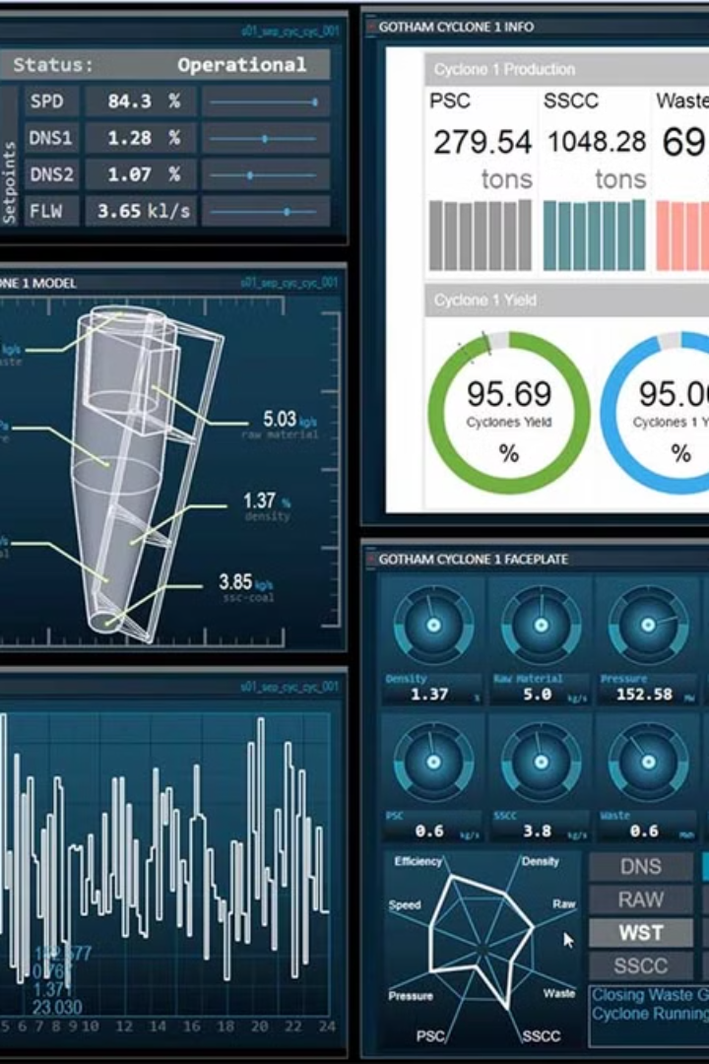




Core Features of Backstage
Software Catalog
Software Templates
TechDocs
Central inventory of all software components with metadata and relationships.
Standardized scaffolding for new services and components.
Documentation-as-code solution that keeps docs close to the code.
Search
Find anything across your entire developer portal quickly.

Slide 7
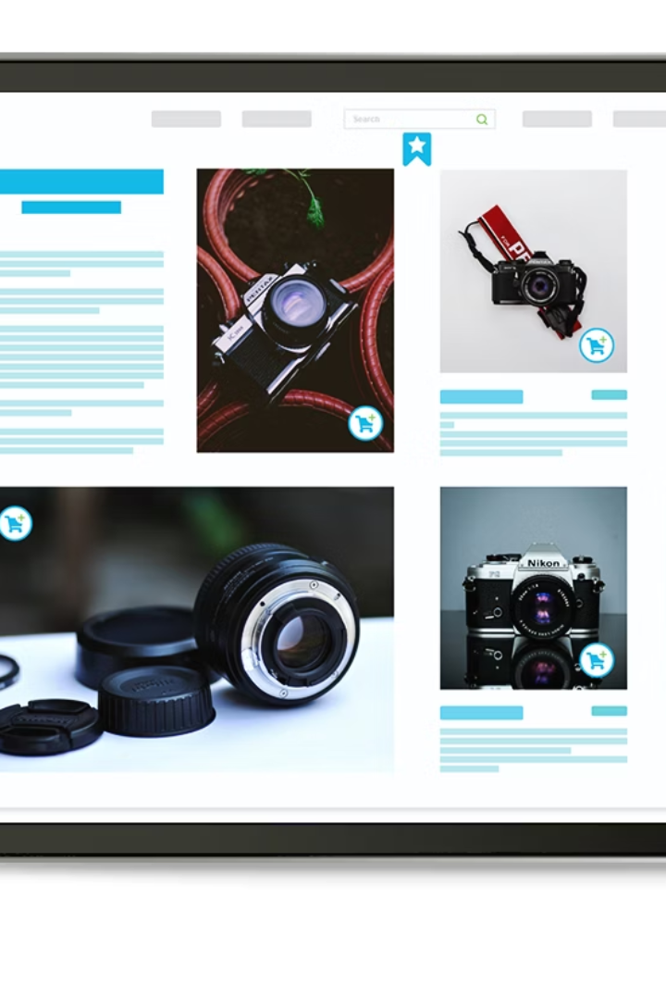




Software Catalog: Introduction
Centralized Inventory
All your software components in one place.
Single Source of Truth
Definitive record for ownership and metadata.
Ecosystem Tracking
Visibility into your entire software ecosystem.
Relationship Mapping
See how components connect and depend on each other.

Slide 8










Software Catalog: Key Components
APIs
Microservices
Document your APIs and their consumers.
Register all your backend and frontend services.
Data Pipelines
Track data flows throughout your organization.
Third-party Software
Include external systems your software interacts with.
Libraries
Catalog shared code and dependencies.

Slide 9
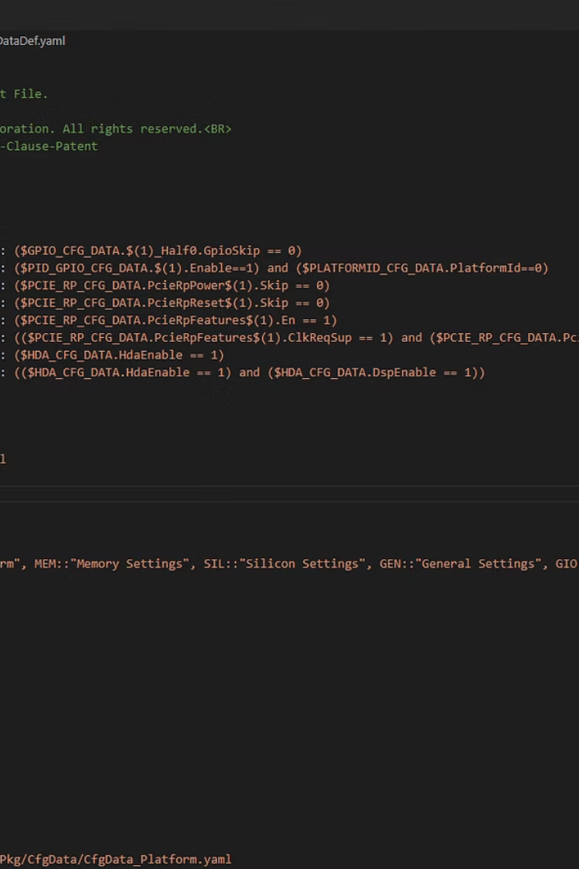
Software Catalog: How It Works
Metadata Definition
Components are defined in YAML files with standardized metadata.
apiVersion: backstage.io/v1alpha1
kind: Component
metadata:
name: artist-web
description: Artist webpage
spec:
type: website
owner: artist-experience
lifecycle: production
Entity Processing
Backstage processes entities using predefined kinds (Component, API, System).
Relationship Mapping
Dependencies and connections are automatically discovered and visualized.

Slide 10
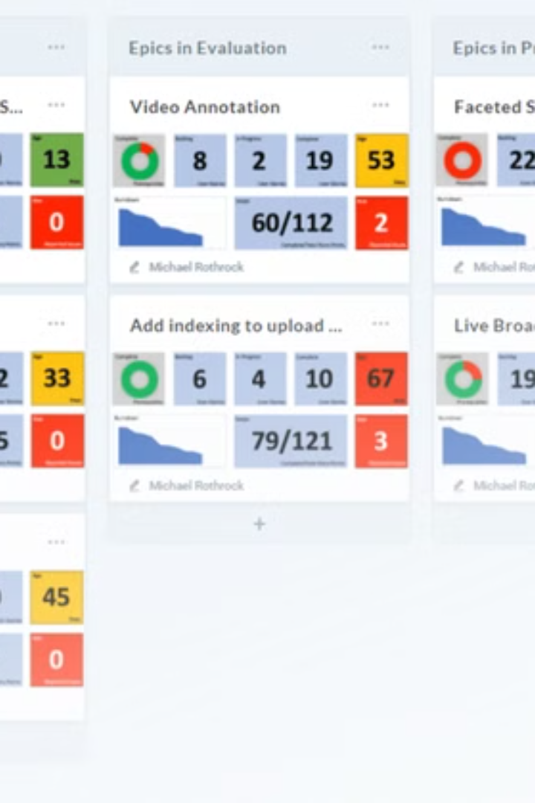
Software Catalog: Benefits
100%
Ecosystem Visibility
Complete view of all software components.
0
Ownership Gaps
Clear accountability for every component.
50%
Reduced Duplication
Teams reuse existing solutions instead of rebuilding.
2x
Discovery Speed
Faster identification of relevant components.

Slide 11
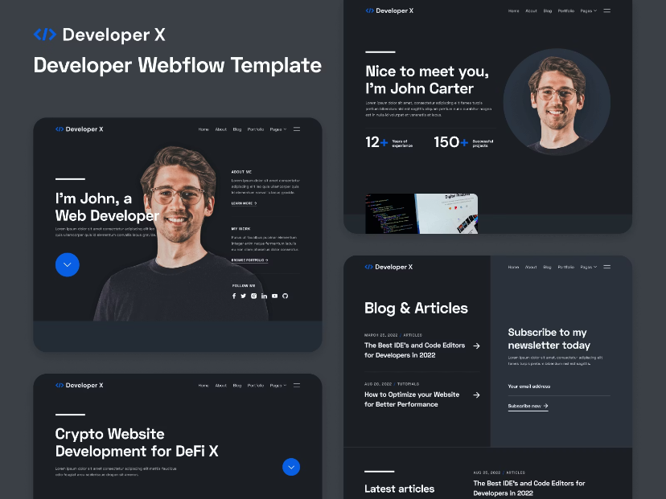
Software Templates: Introduction
What They Are
Templates provide standardized scaffolding for creating new software components. They enforce organizational standards from day one.
Currently in beta release, templates dramatically reduce setup time for new projects while ensuring best practices are followed.
Templates make creating new services, libraries, or websites consistent and simple. They remove friction from the developer experience.

Slide 12



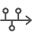
Software Templates: How They Work
Define code skeletons
Create template with variables and best practices
Fill in variables
Developers use Backstage UI to customize
Generate repository
Automatic creation and initial setup
CI/CD integration
Connect with deployment pipelines

Slide 13
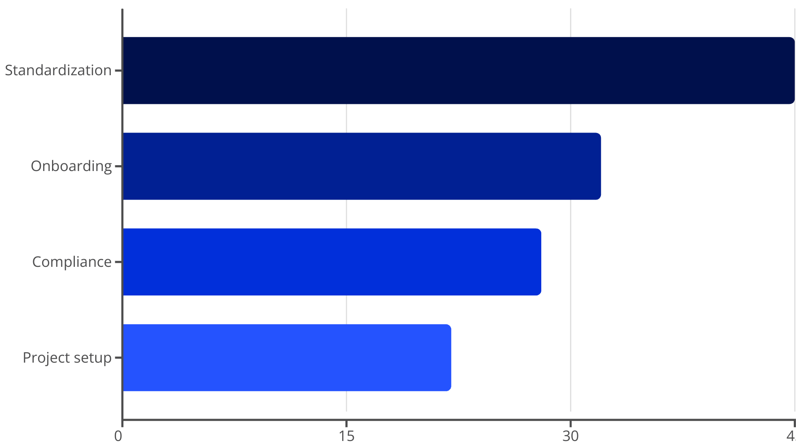
Software Templates: Benefits
By making the right way the easy way, templates encourage developers to follow best practices naturally. They remove friction from doing things correctly.

Slide 14
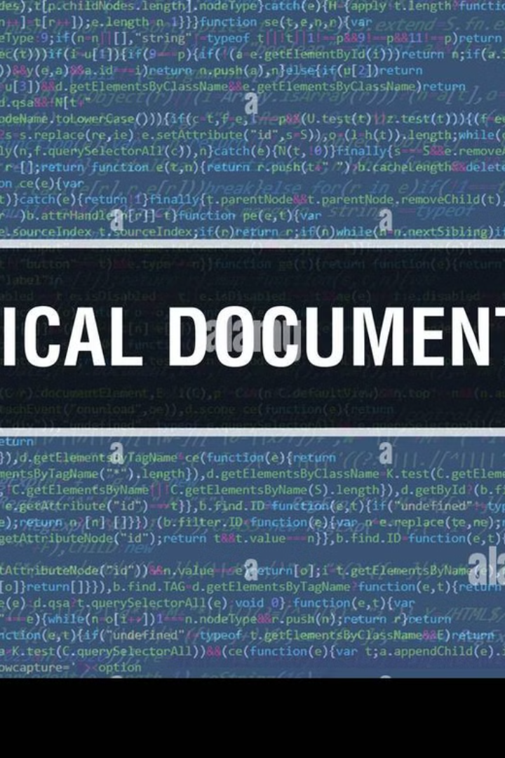
TechDocs: Introduction
Documentation as Code
Centralized Knowledge
Technical documentation written in Markdown, stored alongside source code. Version-controlled like any other code artifact.
All documentation accessible through Backstage. No more hunting through wikis, Google Docs, or Confluence.
Automatic Generation
Documentation sites automatically generated from Markdown files. Always current with the latest code changes.

Slide 15








TechDocs: How It Works
Write in Markdown
Build Site
Create docs alongside code in the repository
MkDocs generates static site automatically
Discover
Publish
Users find docs via Backstage catalog
Site is deployed to TechDocs

Slide 16
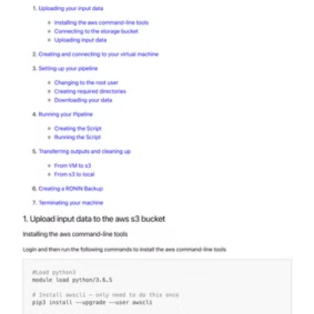
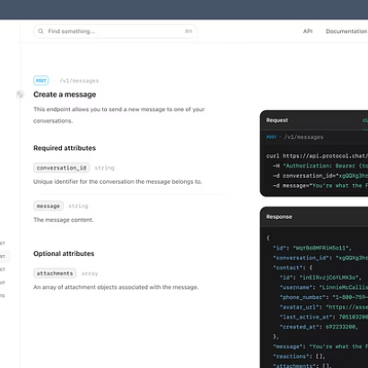


TechDocs: Benefits
Documentation stays current with code changes. Developers stay in their workflow without context switching. Knowledge sharing improves across teams.

Slide 17
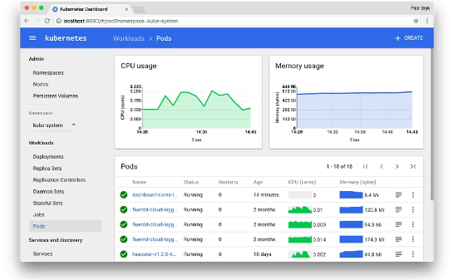
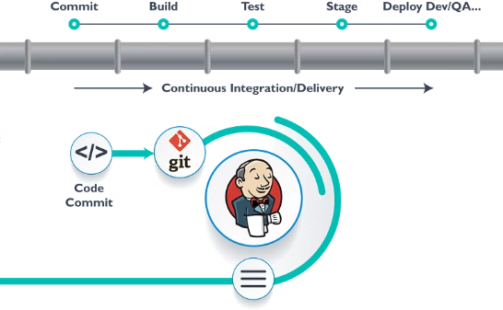
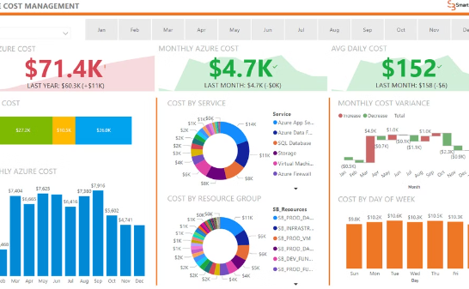
Additional Backstage Features
Kubernetes Integration
CI/CD Visualization
Cost Insights
Monitor K8s resources directly in Backstage. View deployments, pods, and services linked to your components.
See build and deployment status at a glance. Track pipeline executions across your services.
Understand cloud resource costs. Make informed decisions about infrastructure spending.

Slide 18
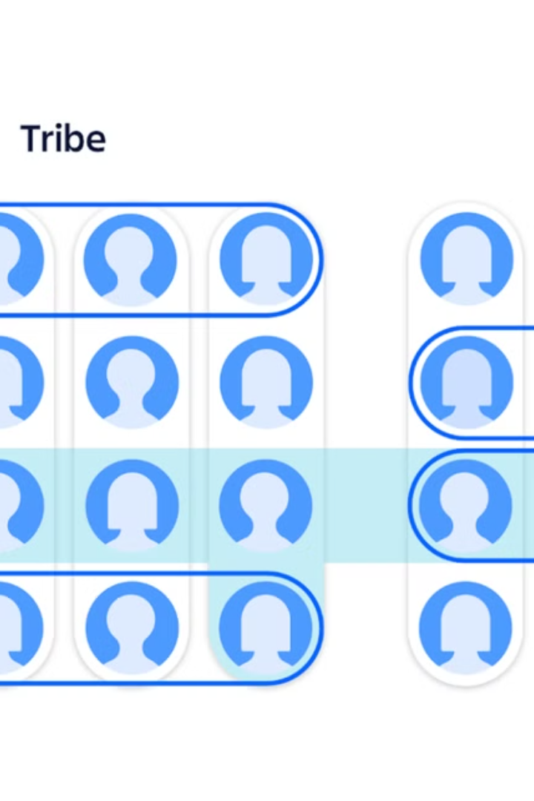
Use Case: Spotify's Internal Implementation
120+
Plugins
Extensive customization for Spotify's needs
100%
Service Coverage
All microservices registered in catalog
75%
Time Saved
On context switching for developers
1000+
Daily Users
Active engineers using the platform
Spotify leverages Backstage for everything from organizing internal hack weeks to managing their extensive microservices ecosystem.

Slide 19
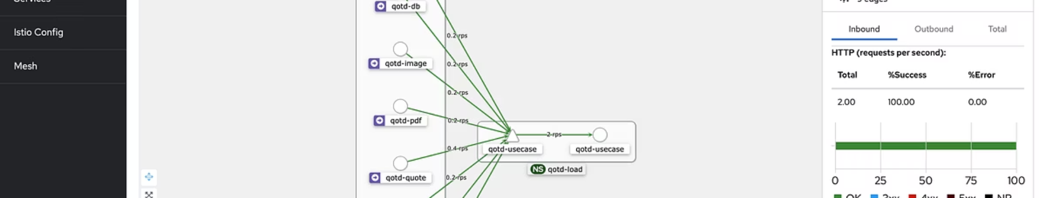
Use Case: Microservices Management
Challenge
Backstage Solution
Outcome
Service discovery difficulty
Centralized catalog
80% faster discovery
Unclear ownership
Mandatory ownership metadata
60% faster incident response
Hidden dependencies
Relationship visualization
40% less deployment issues
Scattered documentation
TechDocs integration
90% documentation compliance

Slide 20
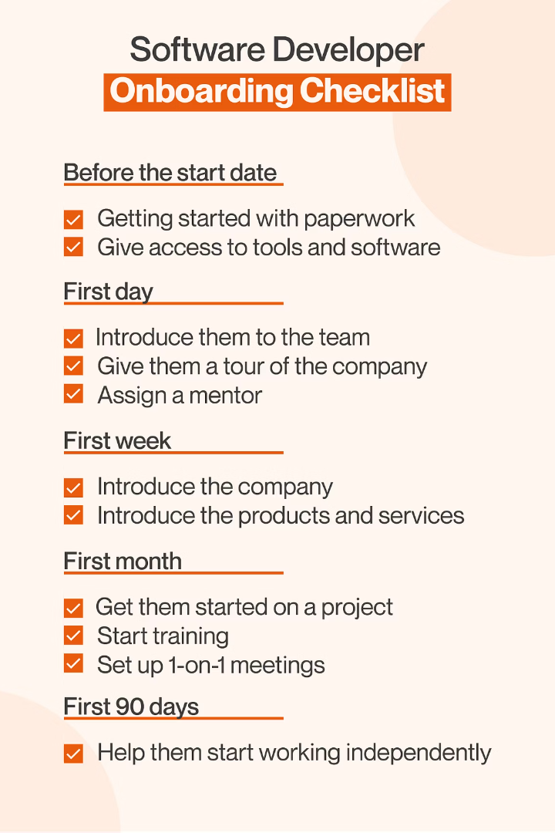




Use Case: Developer Onboarding
Day 1
New developer accesses Backstage. Finds team services and docs.
Week 1
Creates first service using templates. Follows golden path.
Month 1
Contributes documentation. Discovers related services.
Month 3
Fully productive. Understands tech stack and ecosystem.
Companies report new developers becoming productive up to 4x faster with Backstage compared to previous onboarding processes.

Slide 21







Use Case: Infrastructure Standardization
Developer Velocity
Faster development with fewer obstacles
Consistent Patterns
2
Standardized approaches to common problems
Platform Team Impact
Increased reach for best practices
Policy Enforcement
Built-in compliance with requirements
The "Golden Path" approach sets up paved roads for developers, making it easy to follow best practices without constant intervention.

Slide 22
Adoption Challenges and Solutions
Challenges
Solutions
Initial catalog population effort
Automated discovery tools
Keeping metadata current
CI/CD pipeline integration
Integrating with existing tools
Plugin adaptors for legacy systems
Change management resistance
Phased rollout with champions
Developer adoption hesitancy
Focus on developer benefits

Slide 23





Getting Started with Backstage
Installation
Clone the Backstage repo and run yarn install.
Configuration
Set up app-config.yaml with your organization details.
Catalog Setup
Create your first component YAML definitions.
Templates
Define your first software template.
Deployment
Deploy to your infrastructure and invite users.

Slide 24
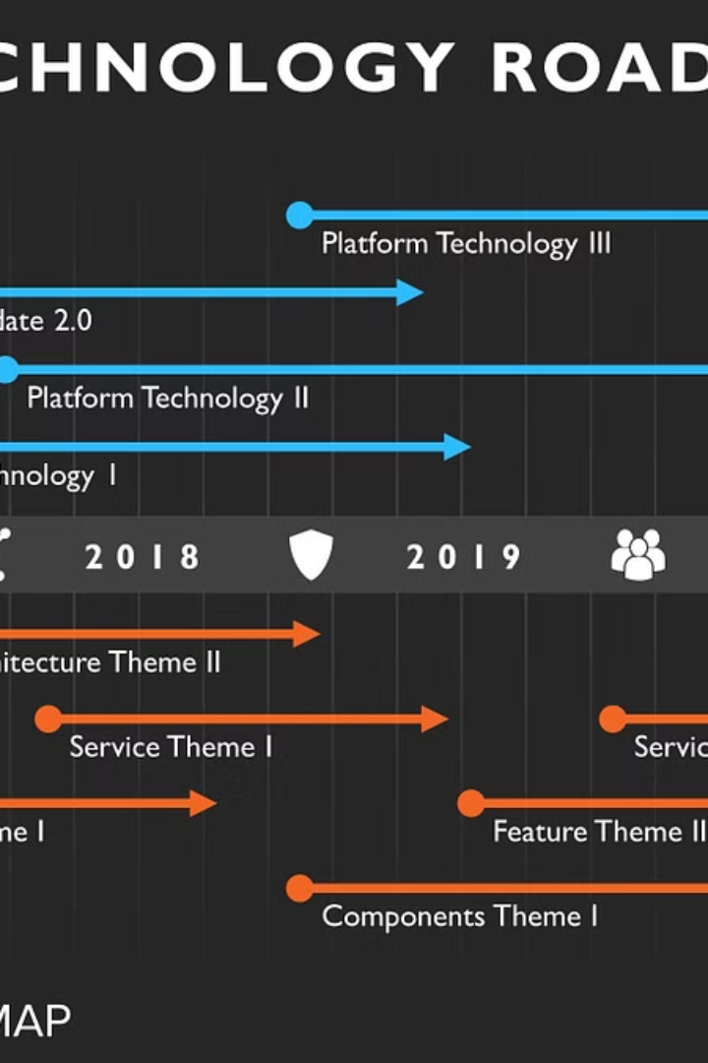




Future of Backstage
Expanding Plugin Ecosystem
Growing community contributions enriching functionality. More integrations with dev tools.
Enterprise Adoption
Increasing adoption by large organizations. Becoming industry standard for developer portals.
AI Integration
Smart assistants for developers. Automated documentation and insights.
CNCF Graduation
Moving beyond incubation status. Deeper cloud-native ecosystem integration.

Slide 25




Conclusion: Why Backstage Matters
Tames Complexity
Creates Alignment
Brings order to chaotic software landscapes
Gets teams following consistent practices
Single Truth Source
Improves Experience
Establishes authoritative software information
Makes developers more productive and satisfied
Backstage provides the foundation for scalable engineering practices as organizations grow. It's become essential infrastructure for modern development teams.

